Slide 1
Data Quality Control of
IRIS/IDA GSN Data
IRIS Metadata Workshop
January12, 2012
Peter Davis
Project IDA
Scripps Institution of Oceanography
University of California, San Diego

Slide 3
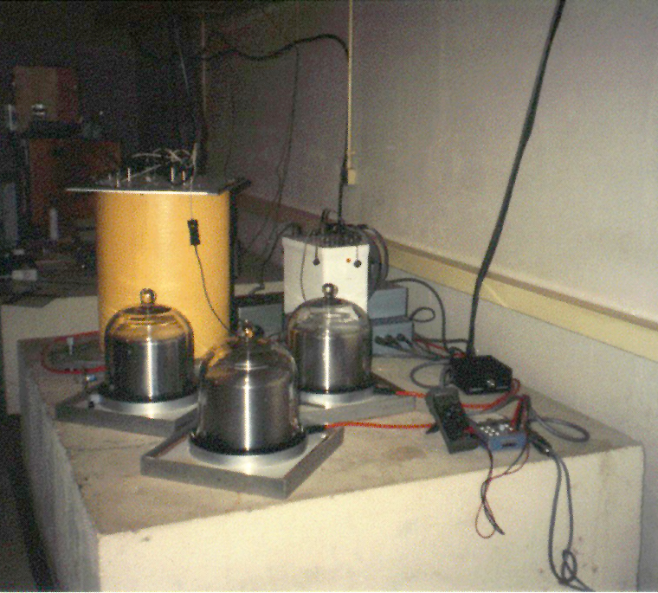
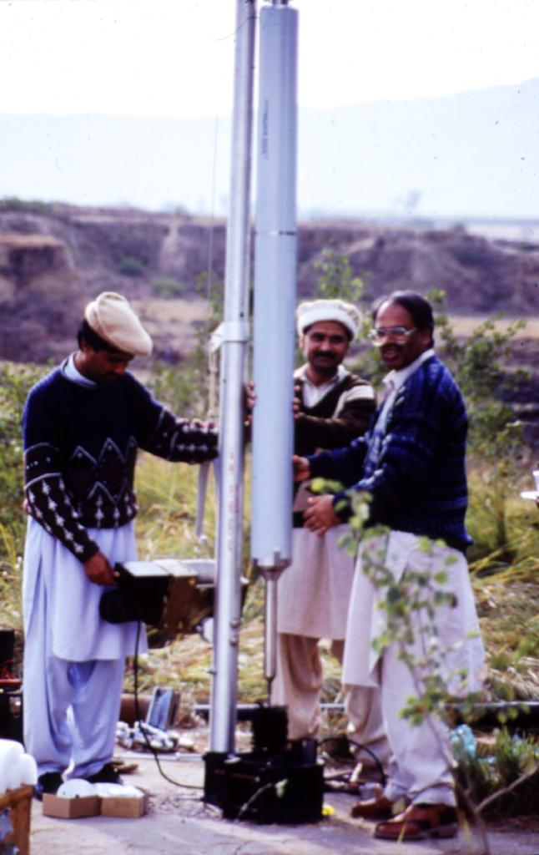
Streckeisen STS-1
Seismometers
Teledyne KS-54000-I

Slide 4
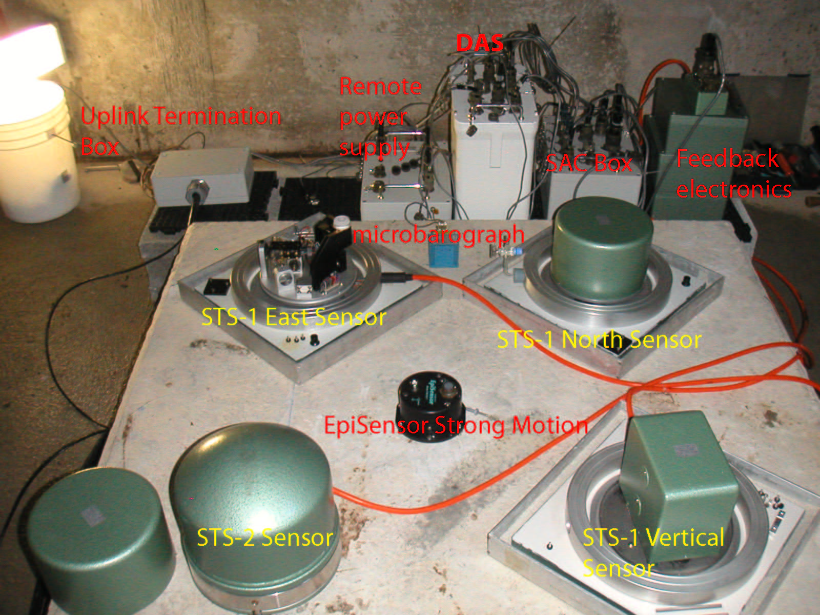

Slide 5
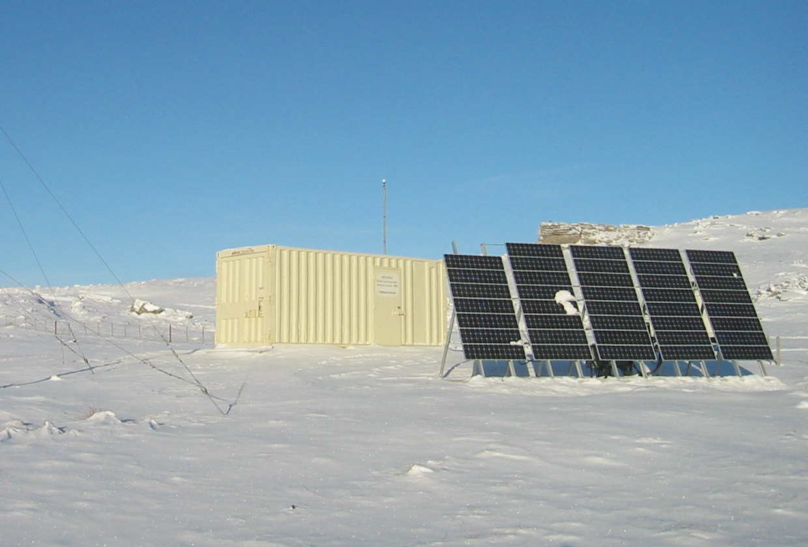
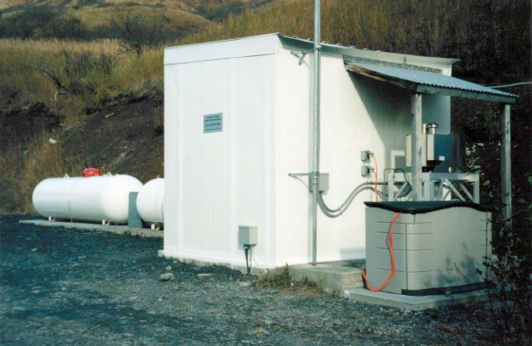
Thermoelectricity
Solar power
Power:

Slide 6
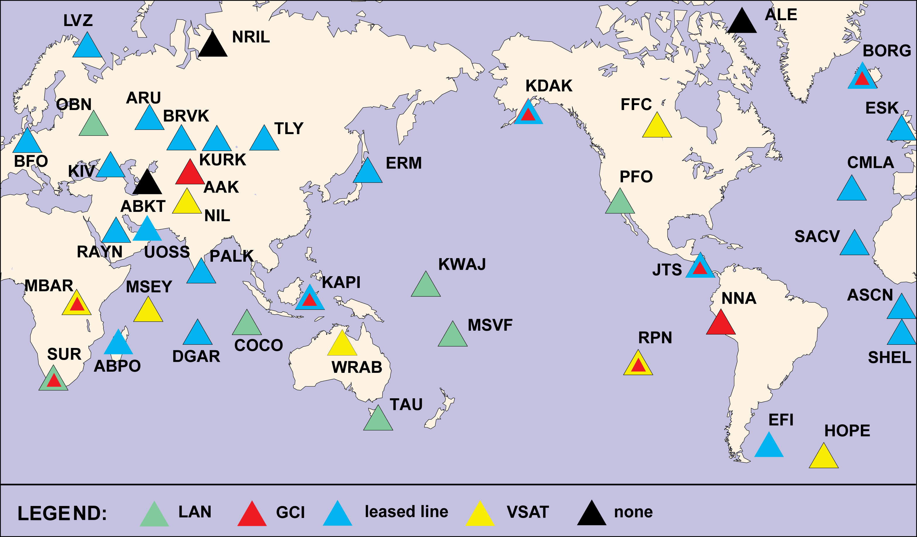
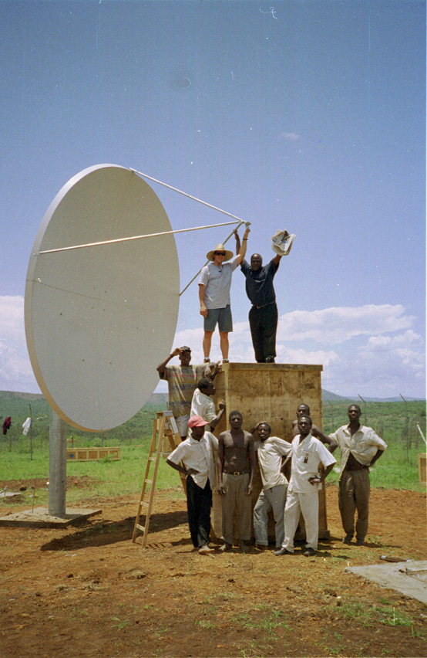
Telemetry links:
LAN
leased lines / VSATs
international dialing
local ISP

Slide 7
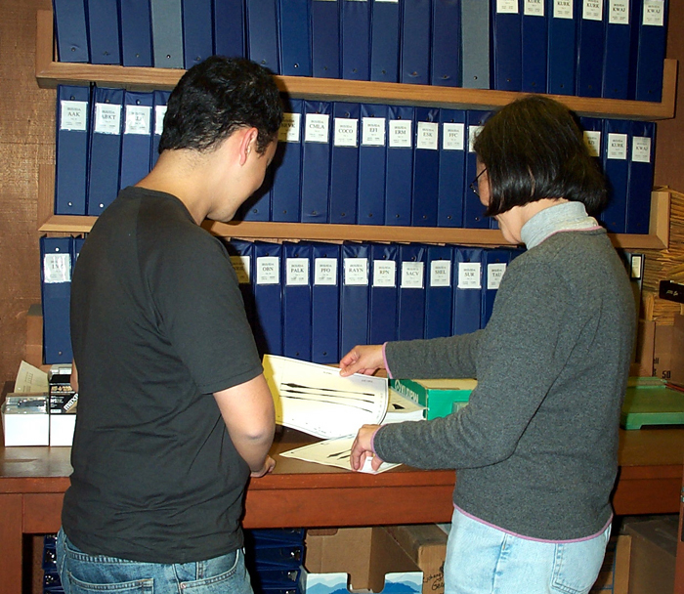
Detecting problems you expect:
(These computer programs written at UCSD.)

Slide 8
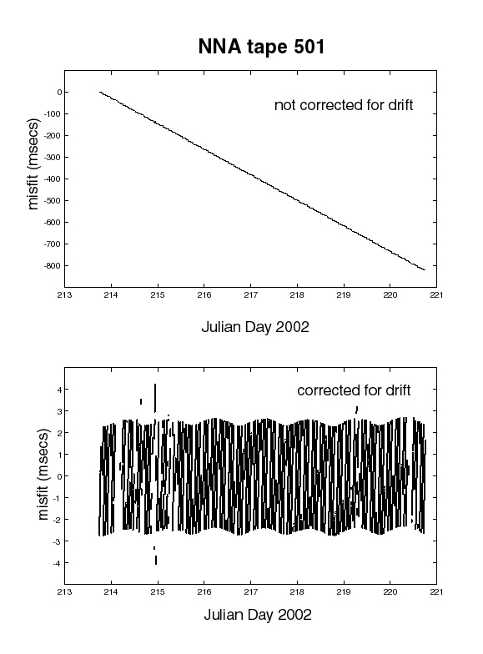
Verify Timing
sample rate correction (clocks on old systems are permitted to drift freely)

Slide 9
Quake 1
Timing check:
(We make use of earthquake locations announced by USGS NEIC.)
Quake 2
Quake 3

Slide 10
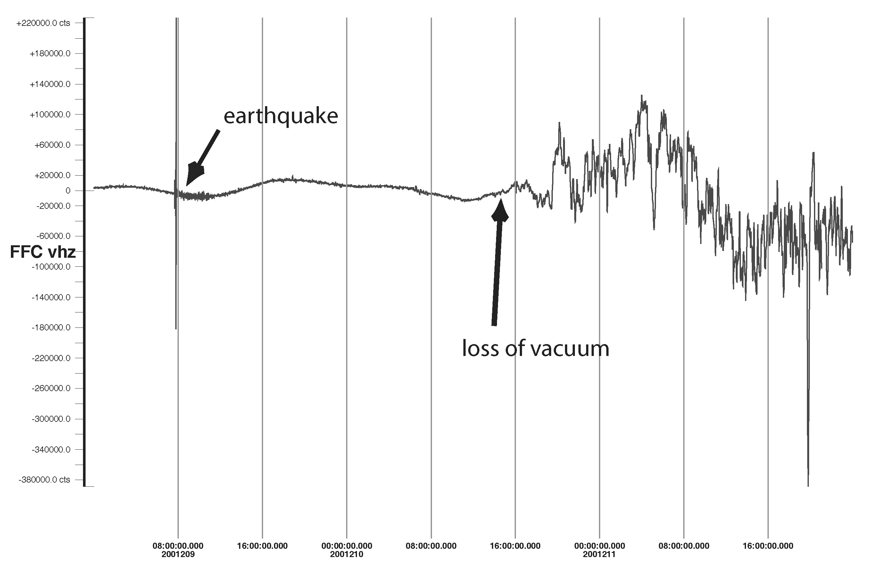
loss of vacuum (We examine long data segments.)

Slide 11
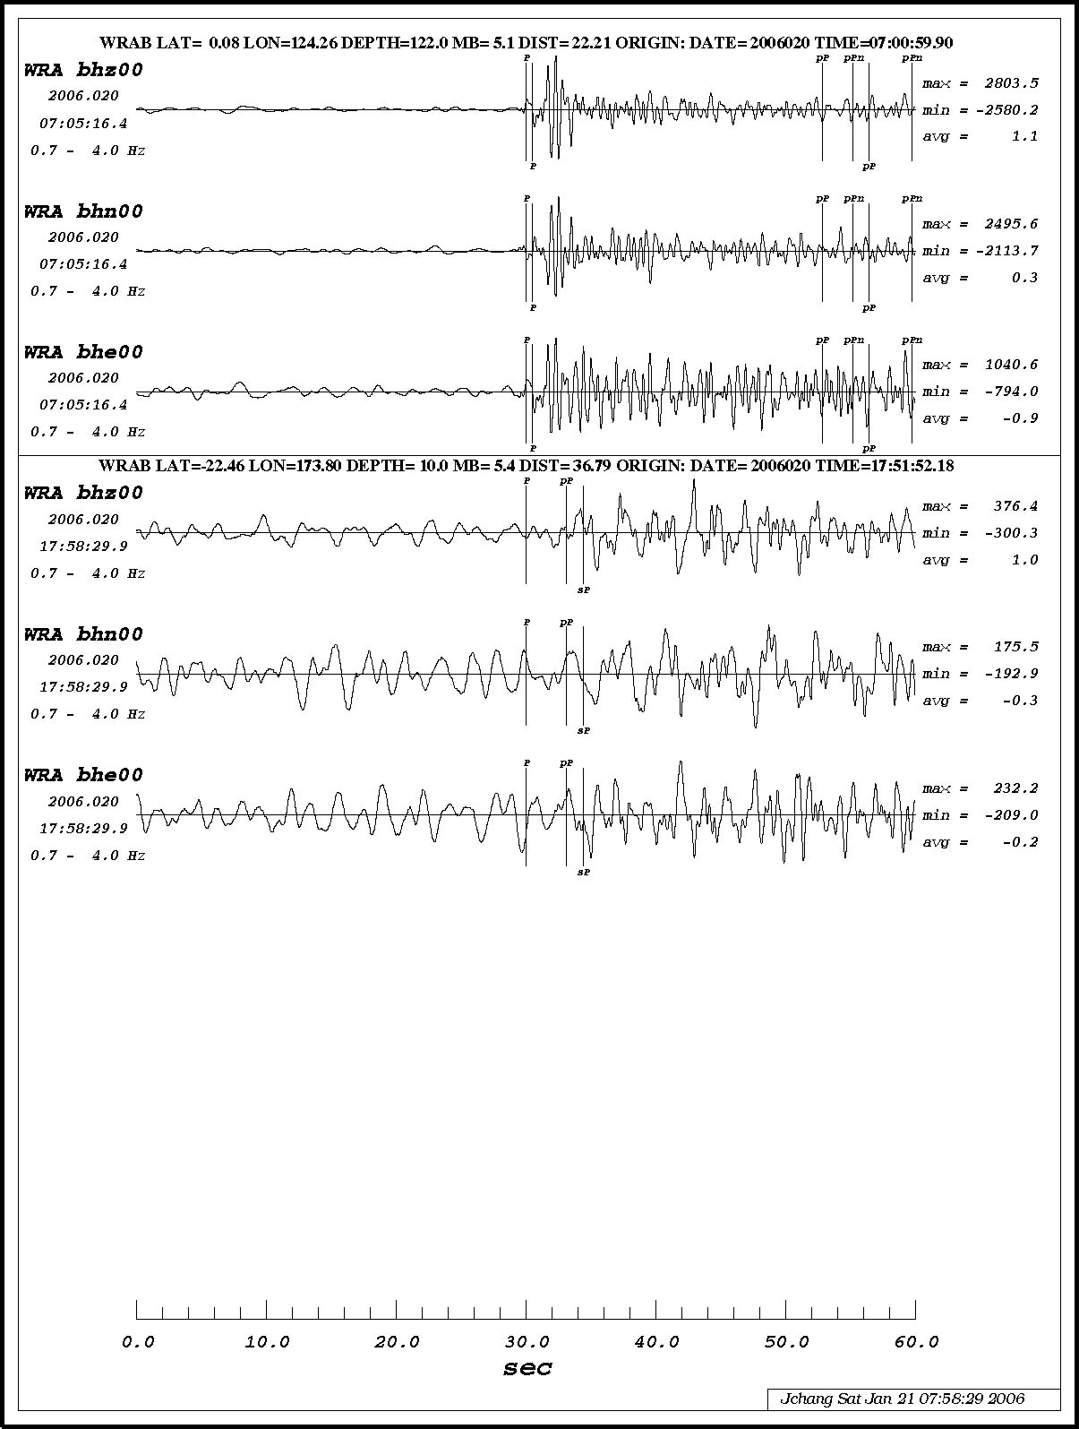
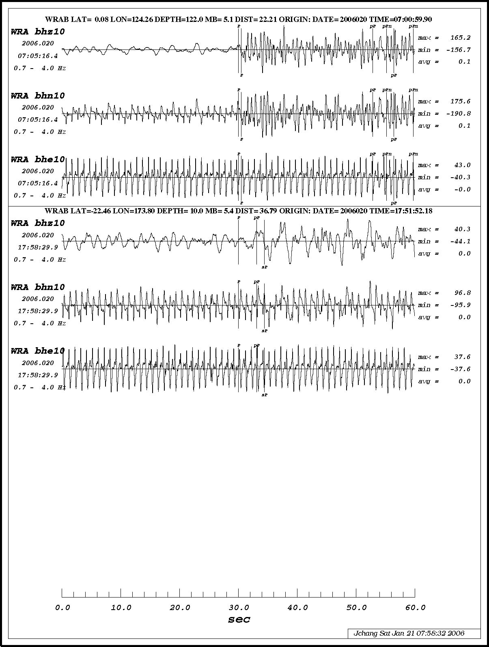
compare primary and secondary sensors(We exploit data redundancy.)
STS2 – failed
KS-54000 – OK

Slide 12
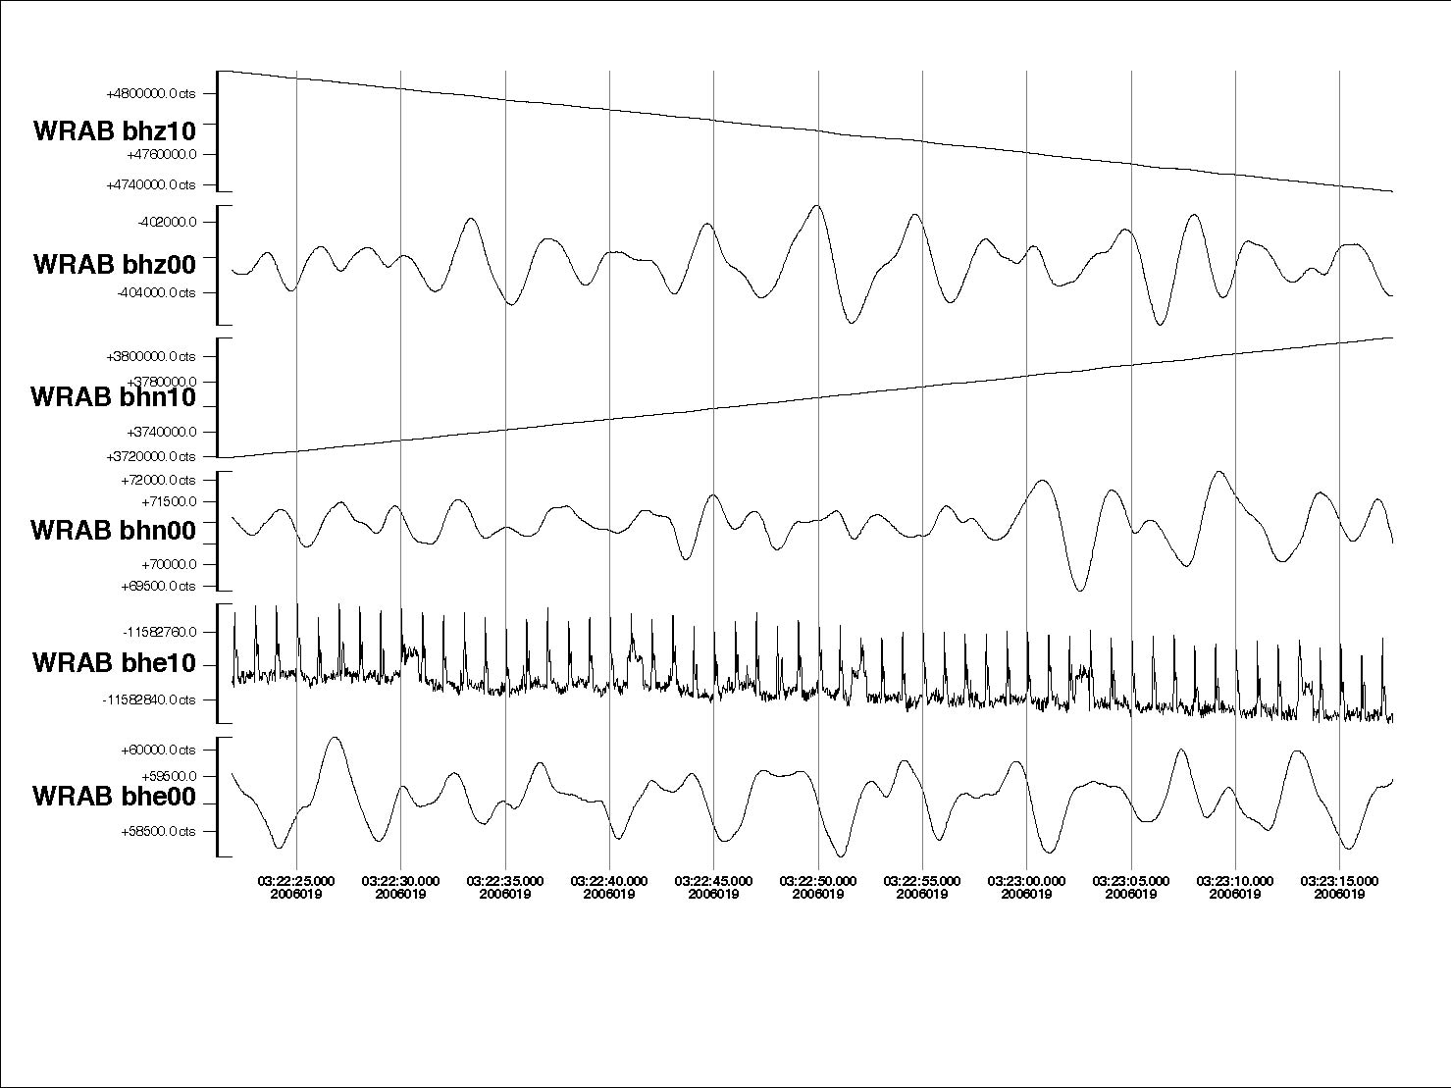
STS2
KS-54000
STS2
KS-54000
STS2
KS-54000
problems unique to tri-axial sensors

Slide 13
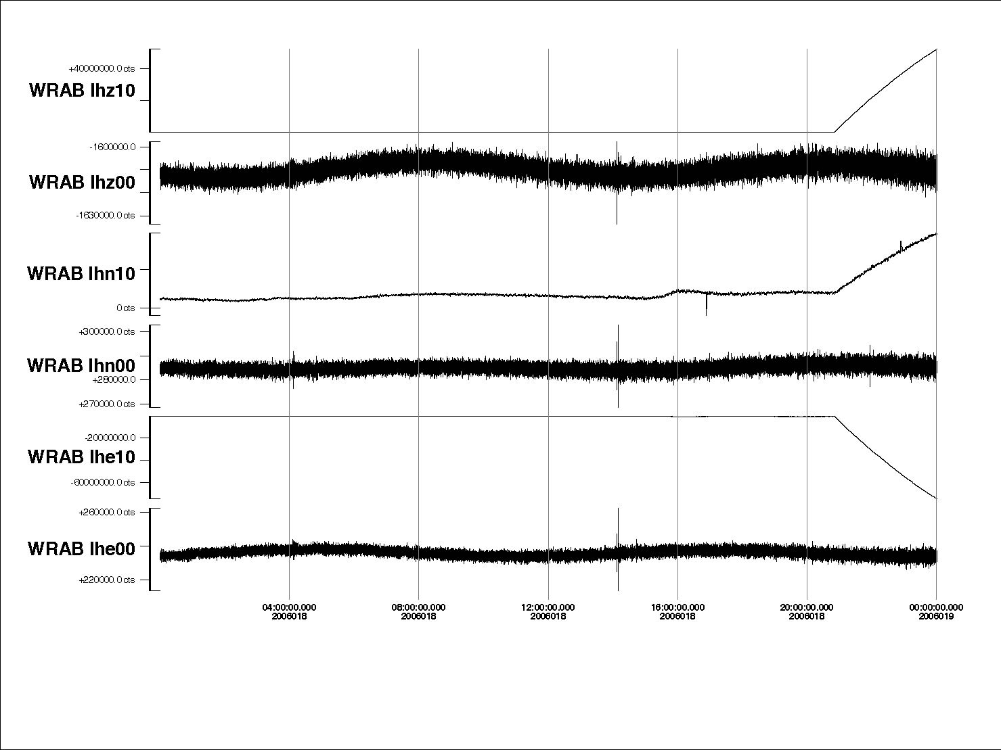

Slide 14
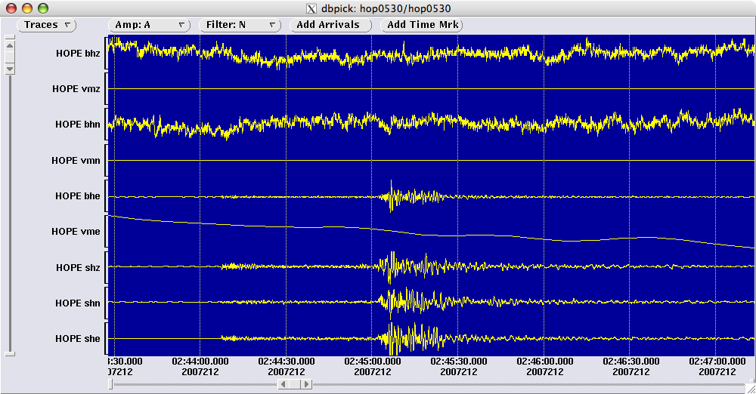
Seismometer masses saturated

Slide 15
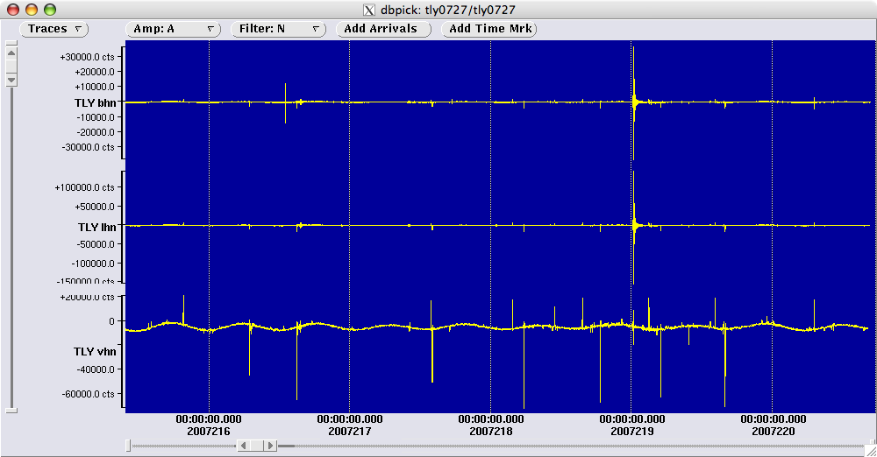
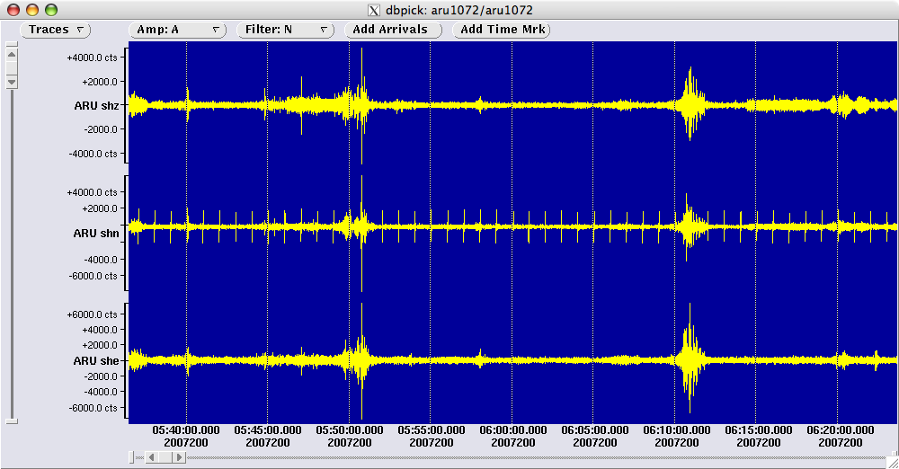
Excessive Spiking

Slide 16
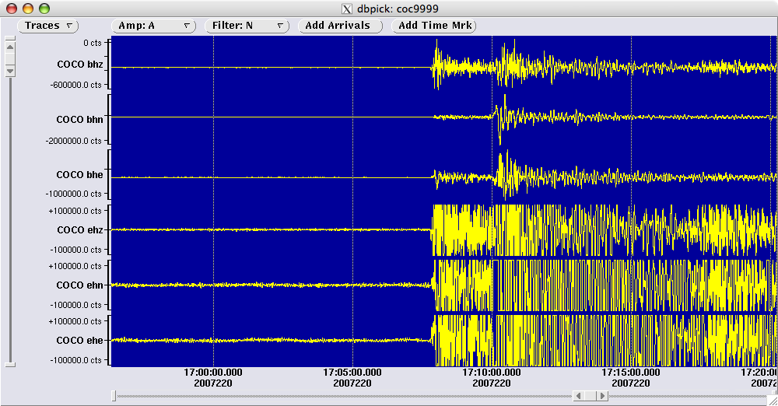
Clipping

Slide 17
Take advantage of IRIS resources:
http://www.iris.edu/servlet/quackquery/

Slide 18
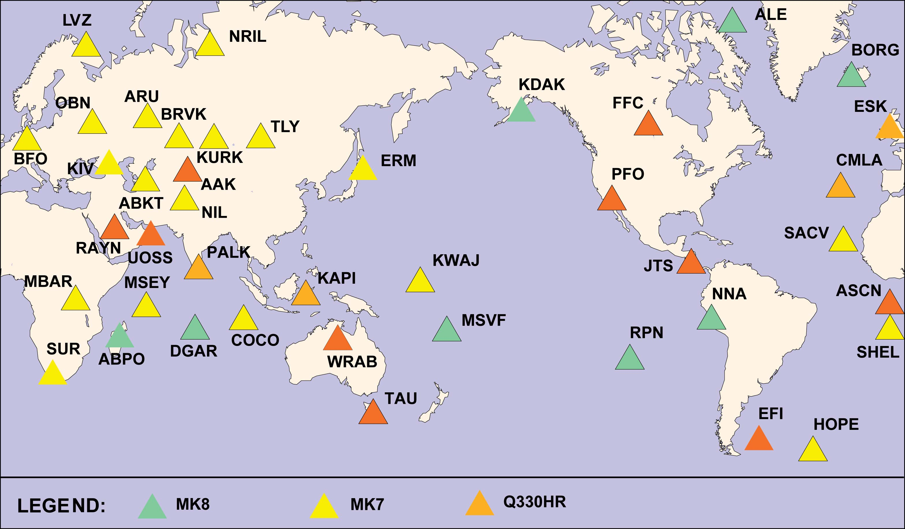
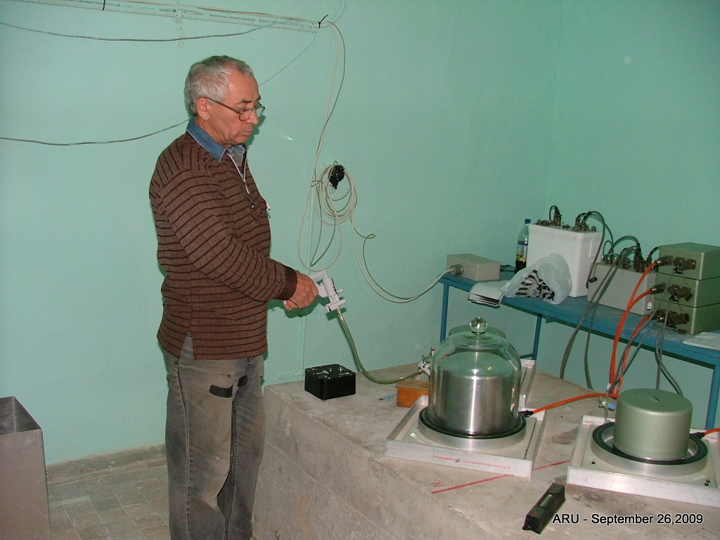
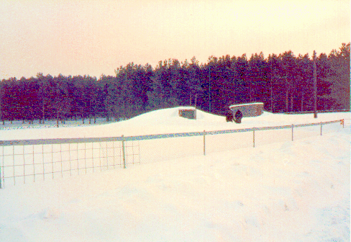
ARU:
Equipment relocated to new vault by EME staff

Slide 19
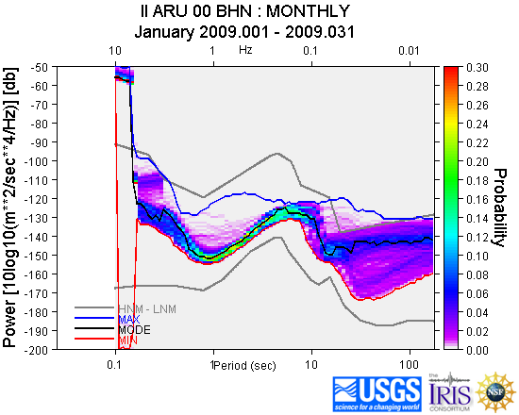
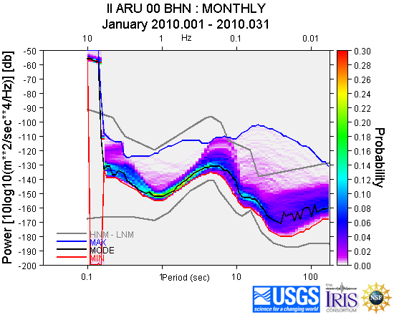
ARU:
http://www.iris.edu/servlet/quackquery/

Slide 20
Take advantage of other resources:
http://www.ldeo.columbia.edu/~ekstrom/Projects/WQC//MONTHLY_HTML/V_2011111_rank.html

Slide 21
Checking that the metadata are correct…

Slide 22
Traditional calibration procedures verified the DAS sensitivity and measured shape of system response.

Slide 23
DC Calibration Test

Slide 25
Convolve model of sensor response with input
Compare observed output with model
Iterate until fit acceptable

Slide 26
Seismometer calibration:
Individual elements of recording systems are well calibrated, but overall system response may be in error.
Independent recording system used to check the GSN system in place with no need to perturb in situ instruments.

Slide 27
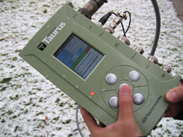
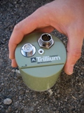
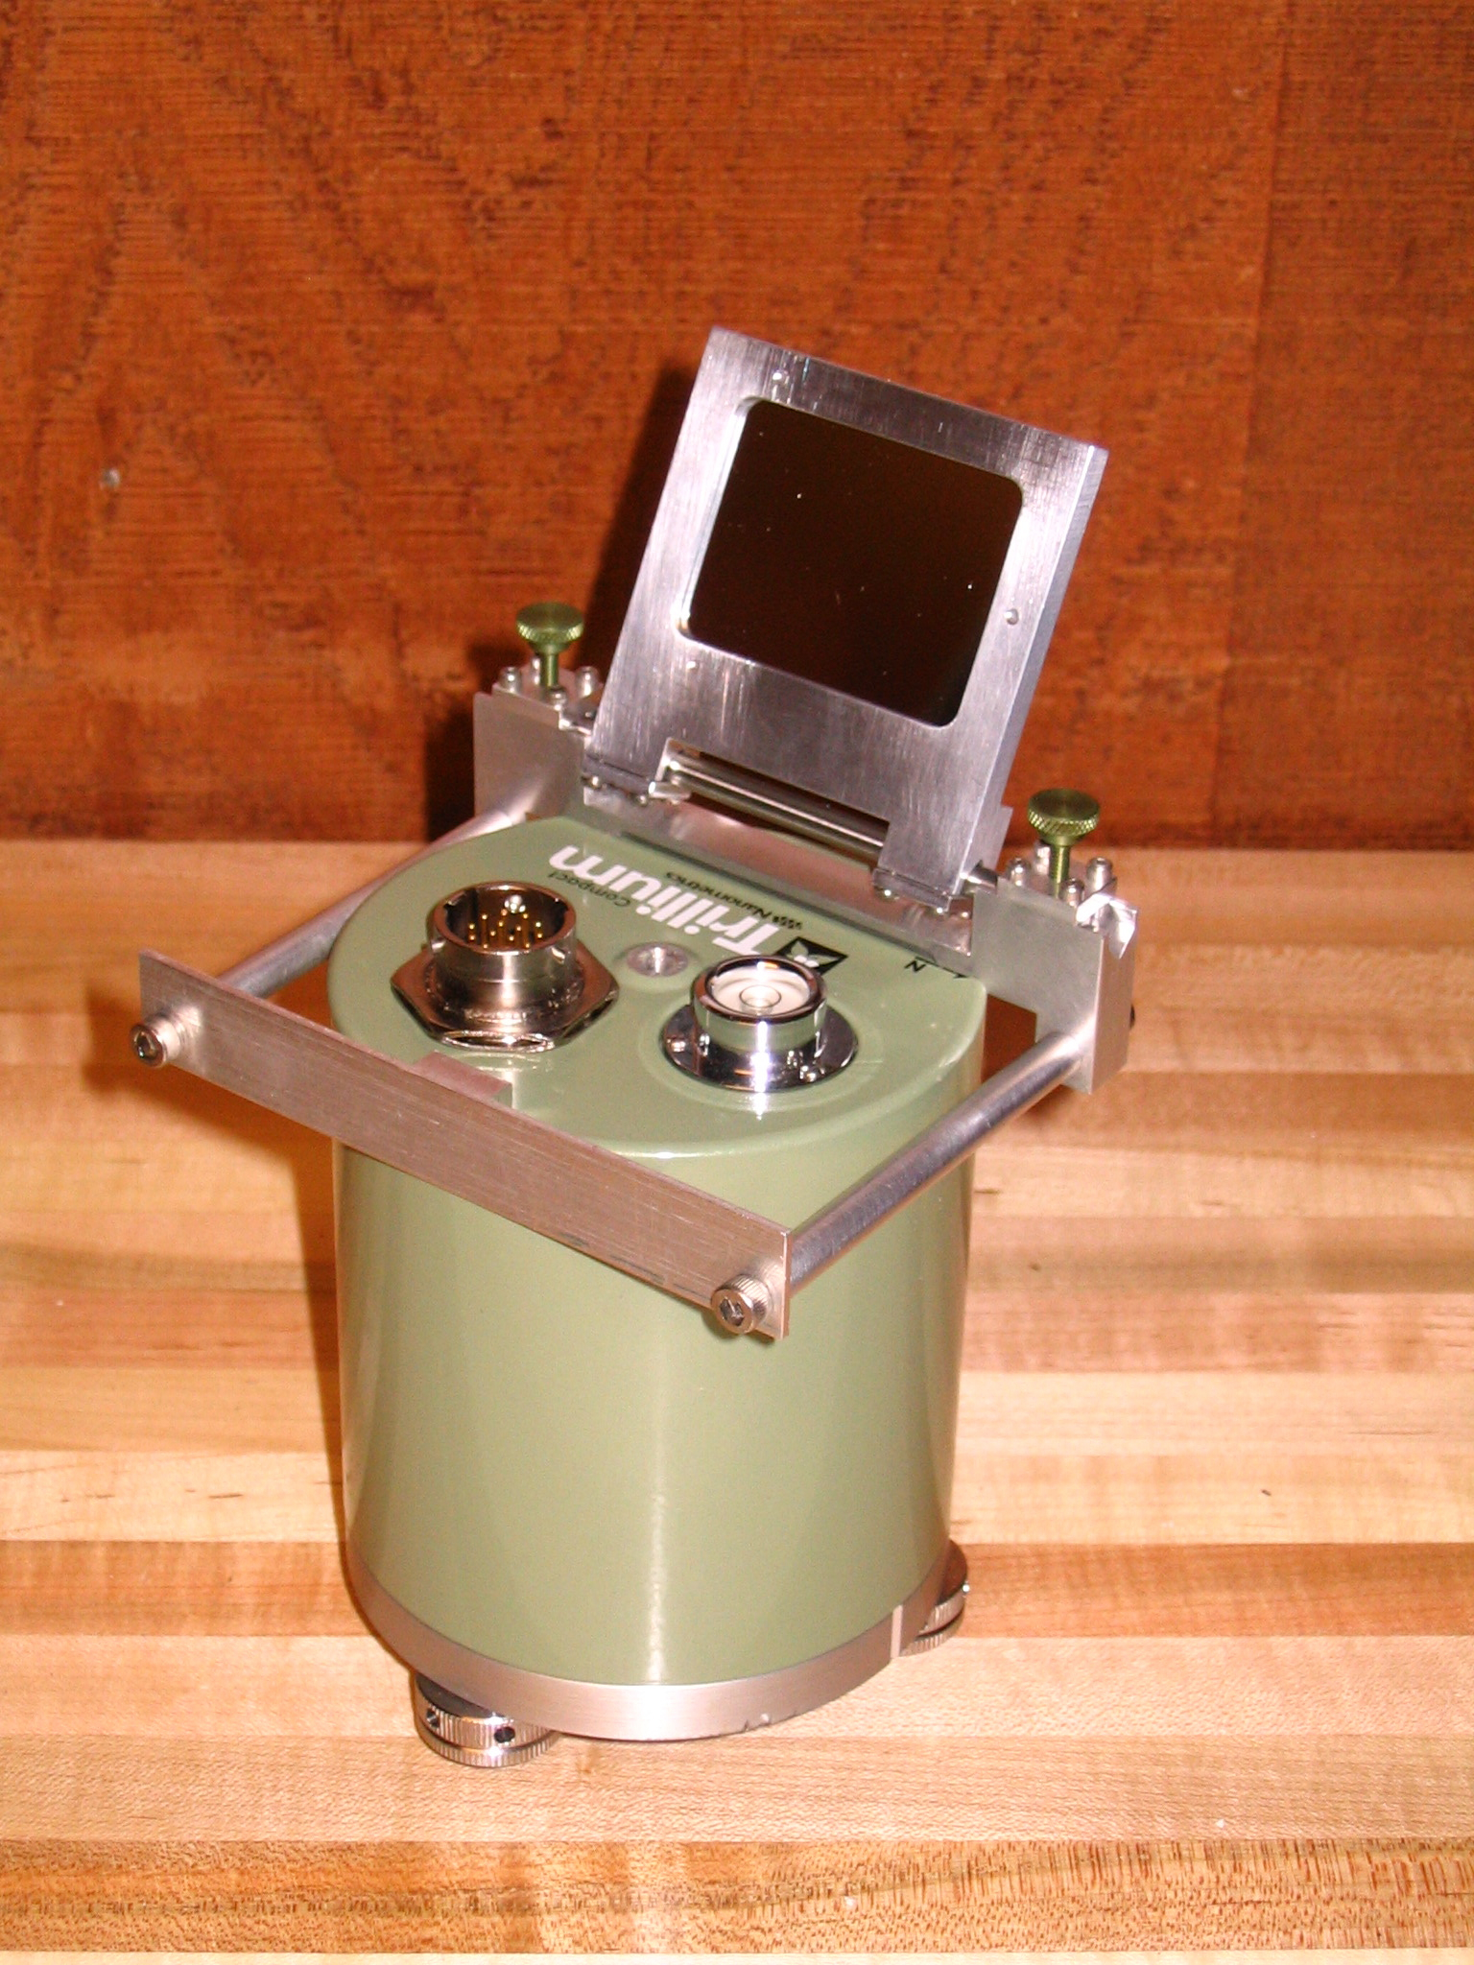
Calibrate with independent, portable sensor:
Nanometrics compact Trillium 120 and Taurus digitizer

Slide 28
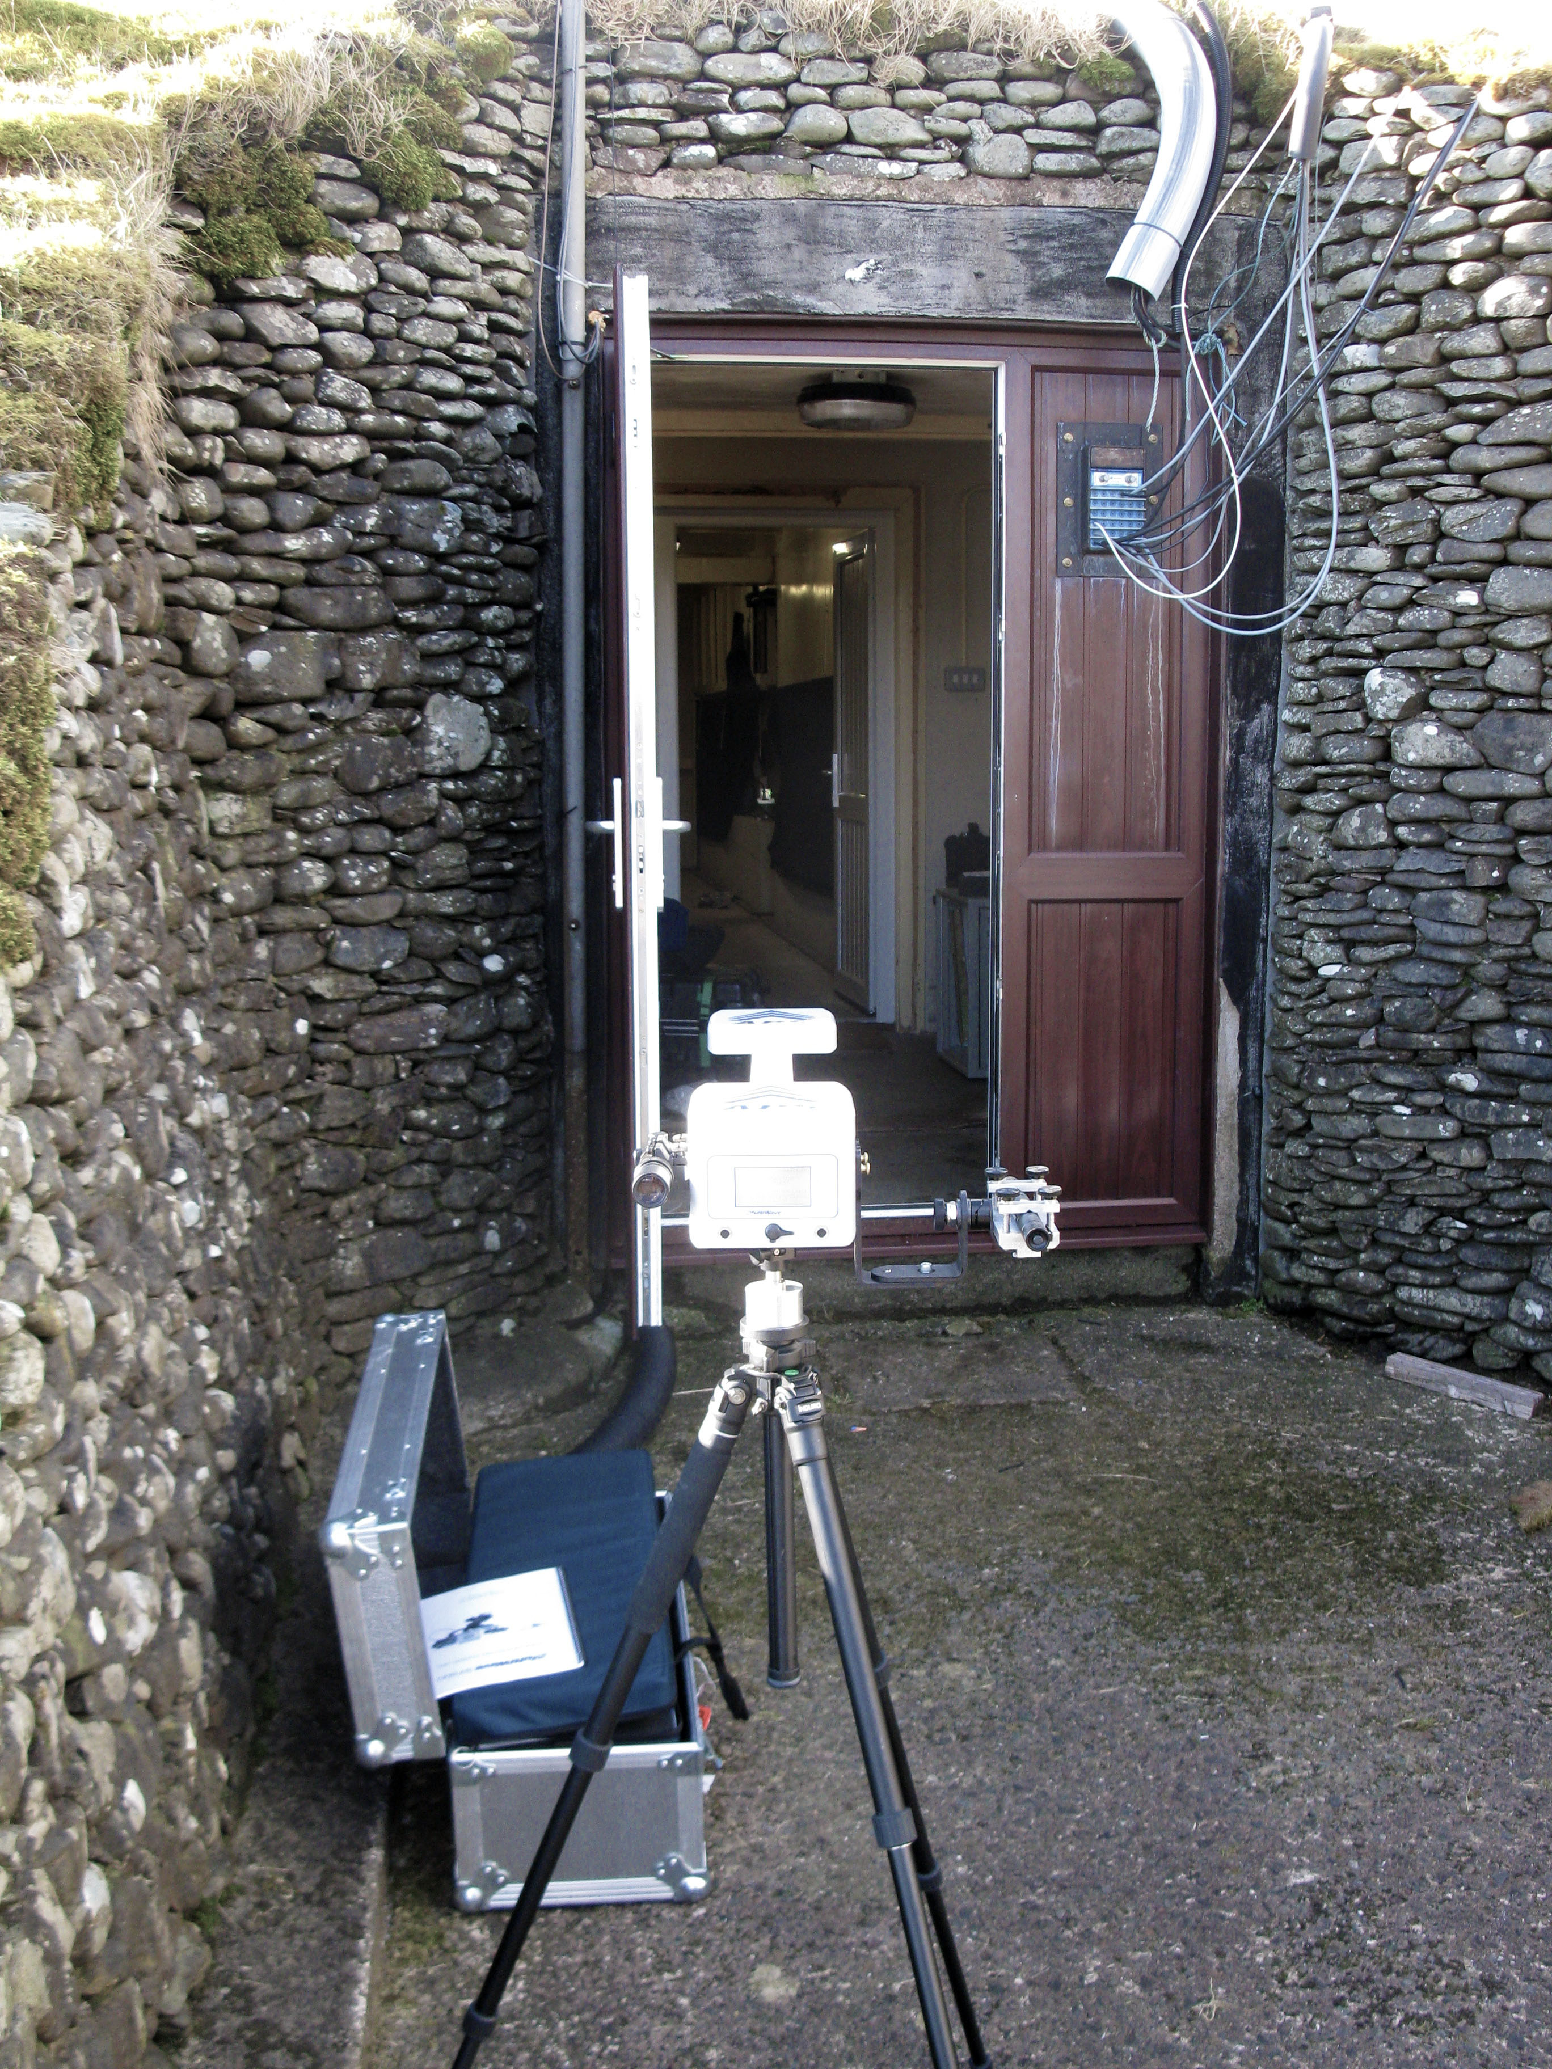
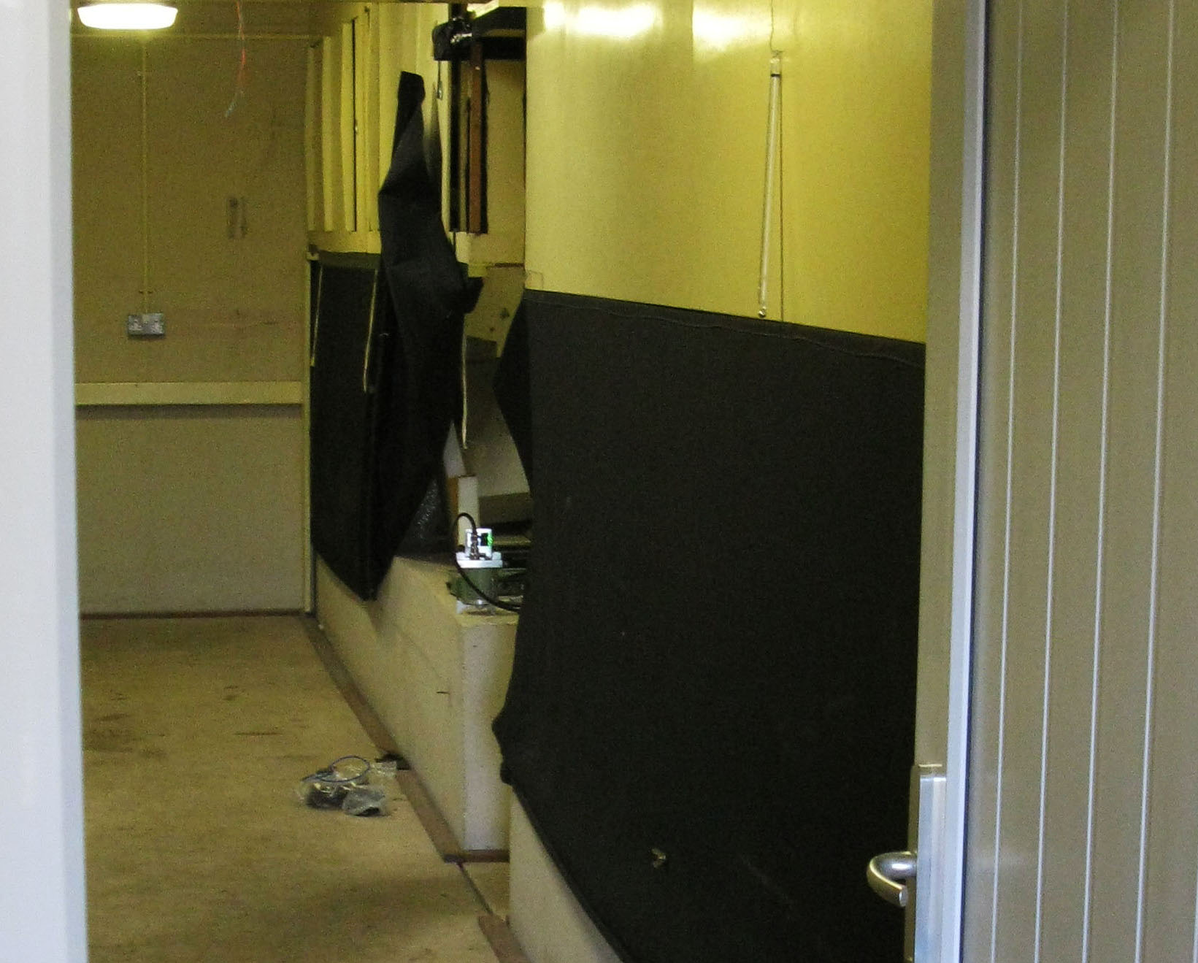
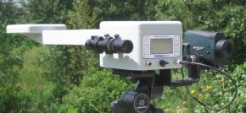
APS used to measure orientation of Trillium
Vault at II- ESK (Eskdalemuir, Scoltland)

Slide 29
Accurate determination of relative response of the common instruments
Accurate determination of relative orientation
2+ hours of microseismic background noise is sufficient for accurate reading

Slide 30
GSN sensor
Reference sensor
GSN sensor
Reference sensor
Sensor Calibration and Orientation

Slide 32
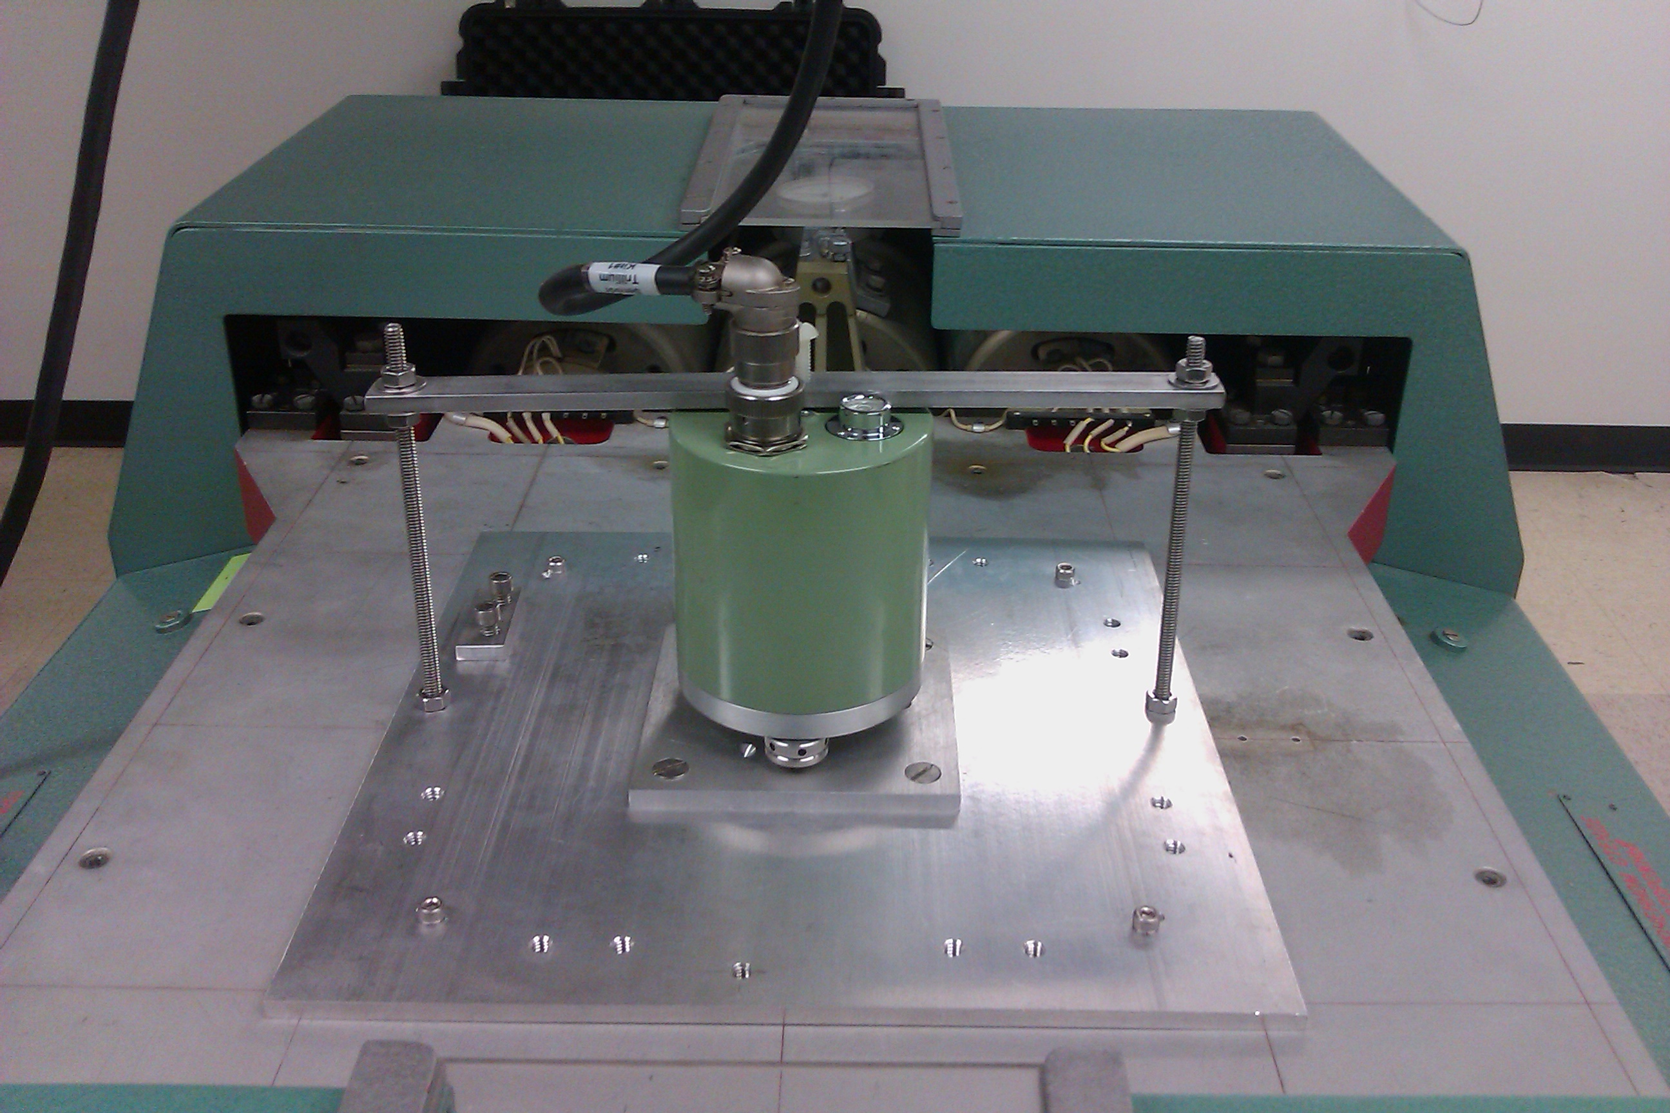
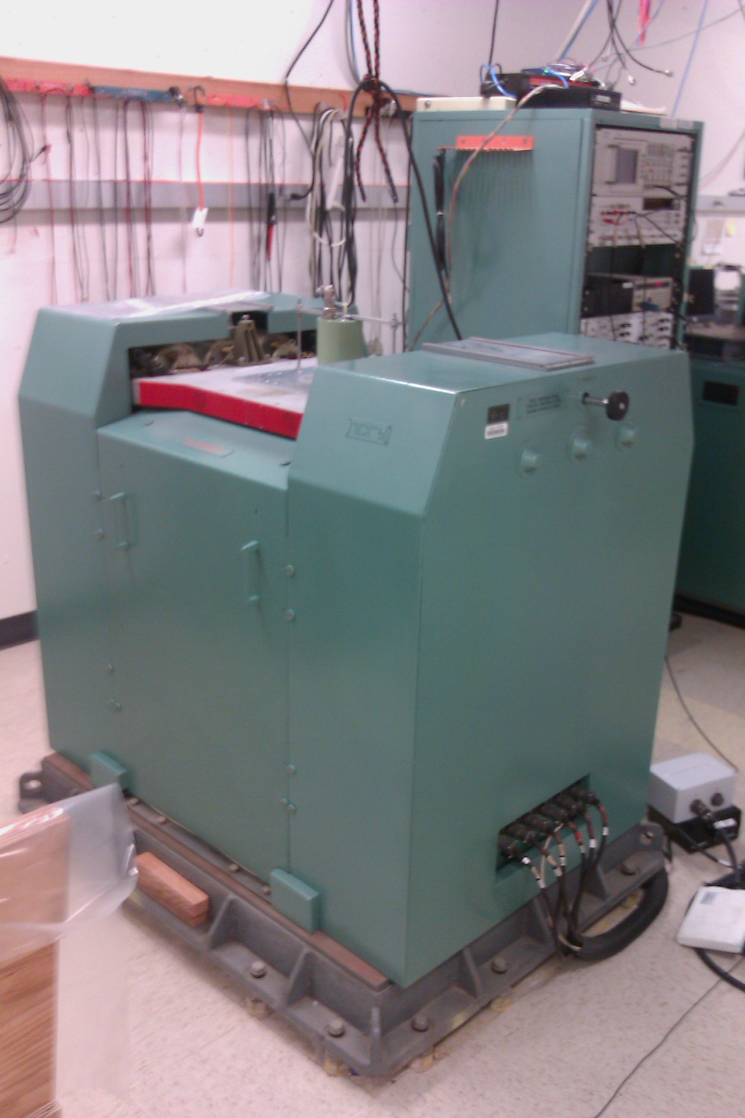
Shaketable at UCSD

Slide 33
Effectiveness of the calibration program can be assessed using long period modes excited by large earthquakes
First used by Davis et al. (2005)

Slide 34
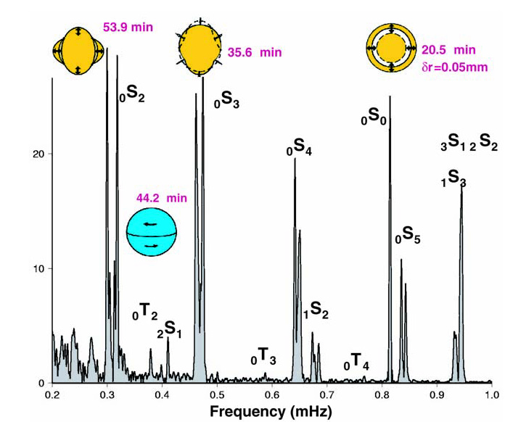
Sumatra-Andaman earthquake excited many low frequency normal modes
Figure from Park et al. (2004), courtesy G. Roult

Slide 35
Distributions identify problematic responses…

Slide 38
Use the Earth’s tides:
Tides are a continuous, constant signal
Tidal amplitudes can be predicted to 1% accuracy globally
Tides are observed at all times at most GSN stations

Slide 39
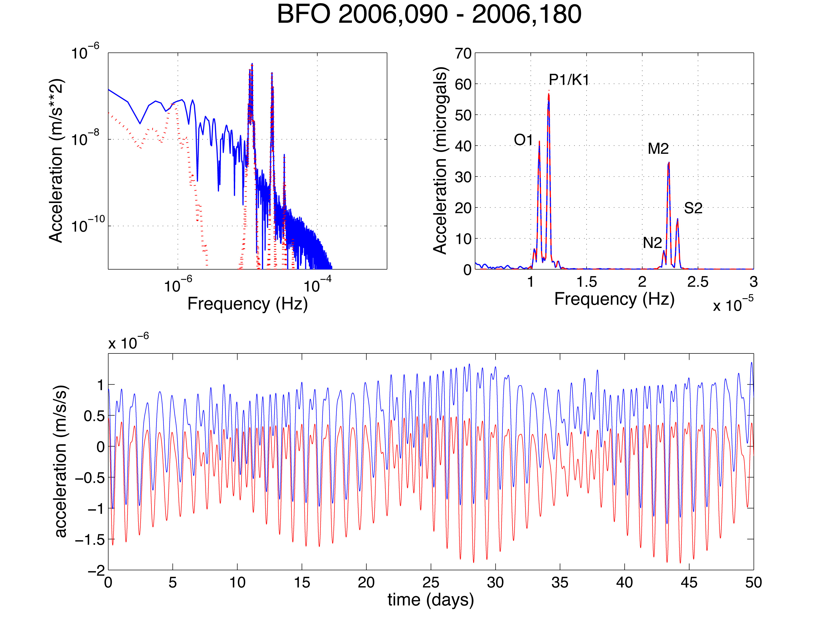

Slide 40
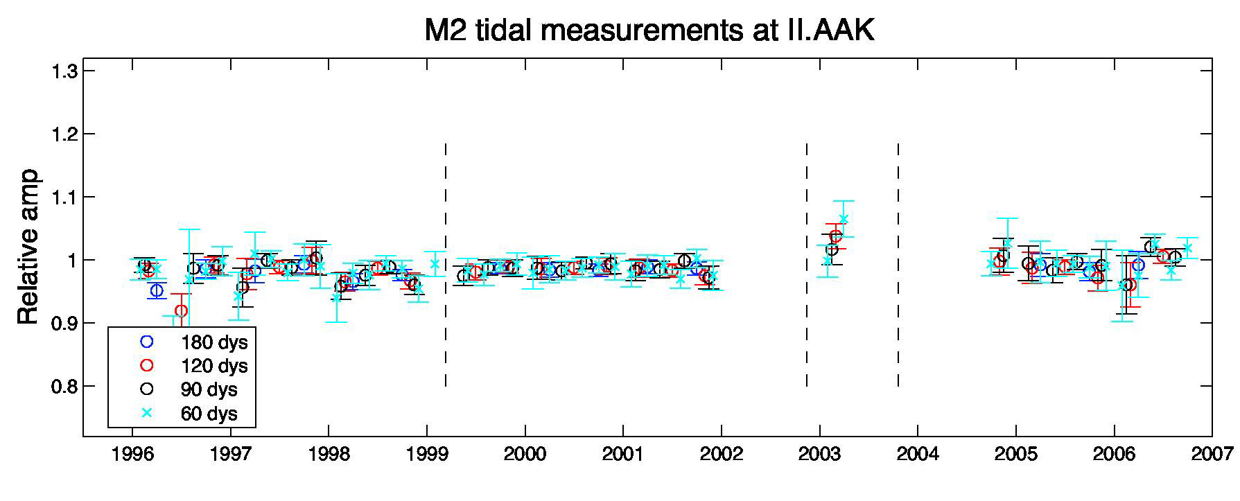
Date
A station well fit:

Slide 41
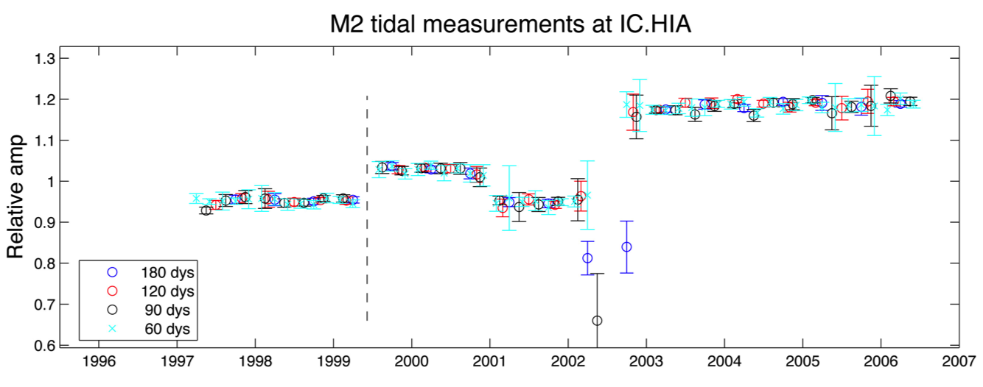
A station poorly fit:

Slide 42
Conclusions:
The GSN re-calibration program is progressing well with 64 / 153 station completed (42 %)
The program is effective at improving both the accuracy and reliability of the response information published for the GSN network.

Slide 43
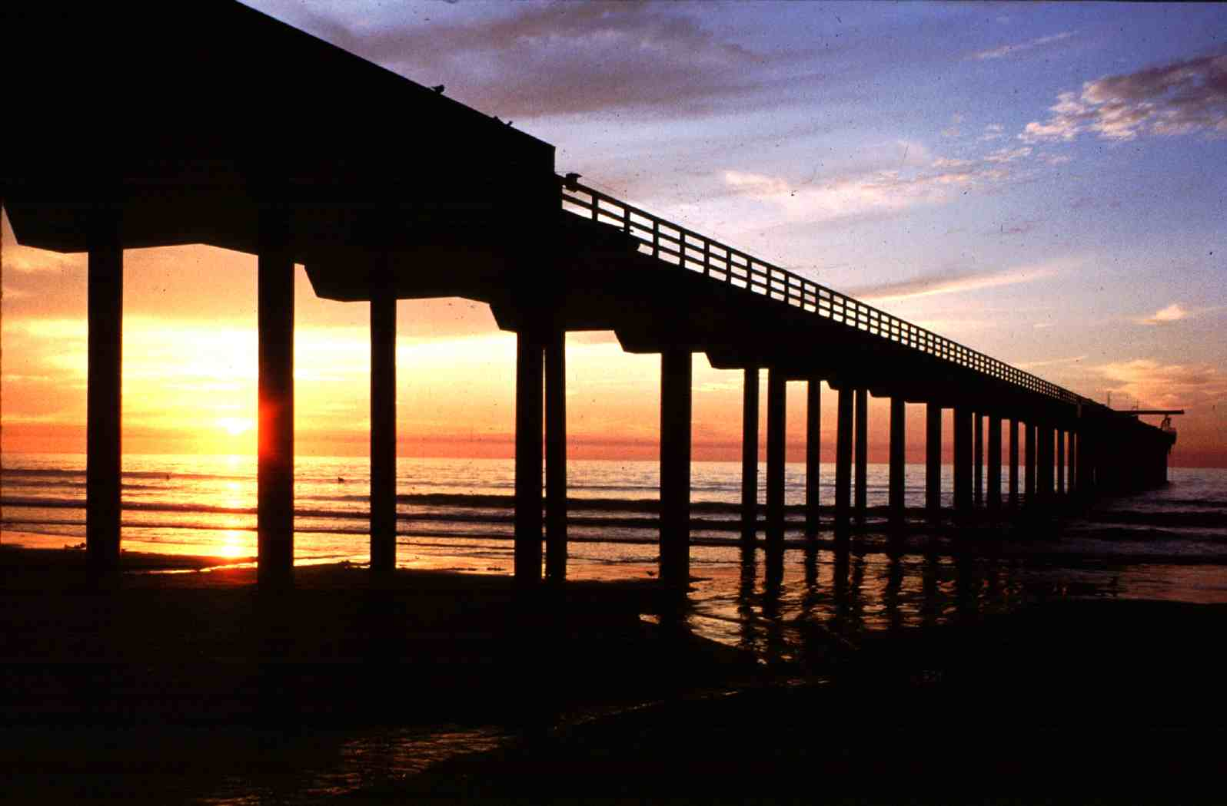
Pier at the Scripps Institution of Oceanography, UCSD

